Slide 2
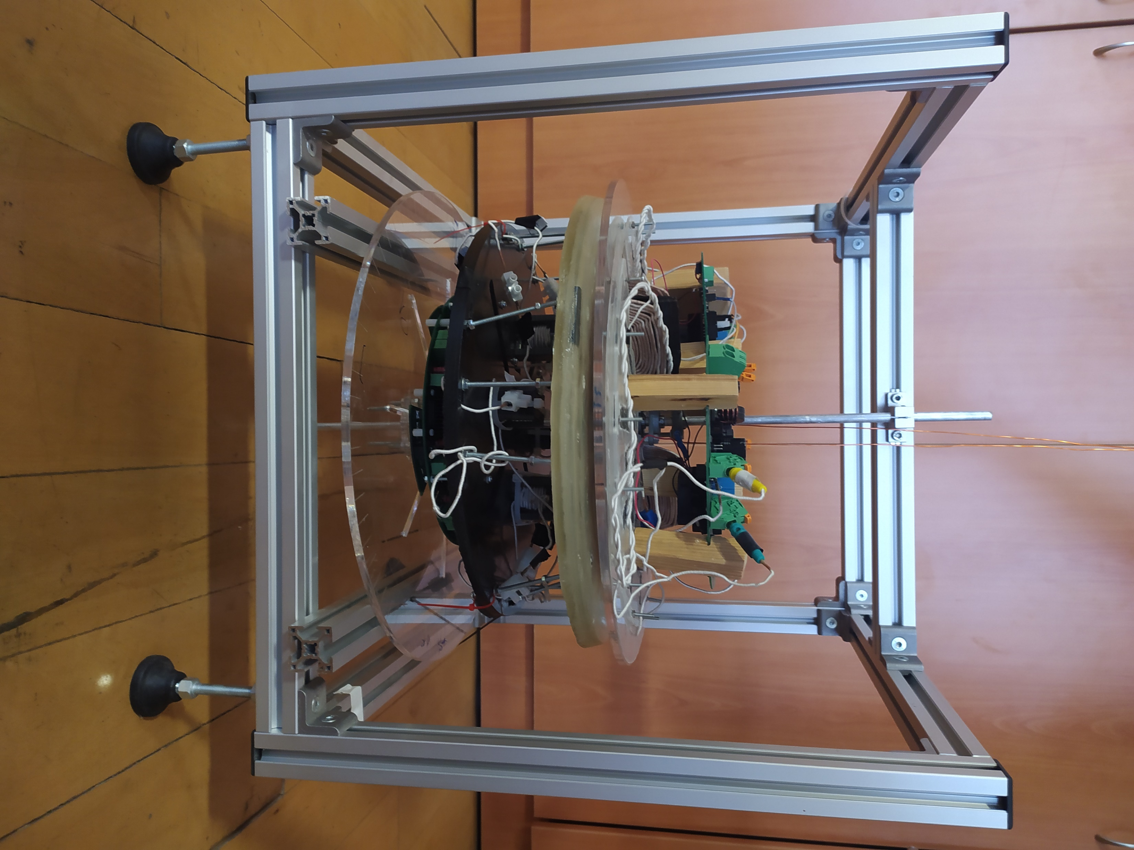
Power Supply
Load
IPT System
Oscilloscope
(a)
HFCI
Tx converter
MSR coil
Tx coils
Rx rectifier
(b)

Slide 3

HFCI
Tx converter
MSR coil
Tx coils
Rx rectifier

Slide 4
HFCI
Tx converter
MSR coil
Tx coils
Rx rectifier

Slide 5
